Slide 1

Exploratory Data Analysis on ODI Batting Statistics
Presented by :
Saurabh Shirole

Slide 2



About me
Name : Saurabh Kailas Shirole
Education : Bachelor's in Computer Science
http://www.linkedin.com/in/saurabh-shirole-19136a361
https://github.com/saurabhks001

Slide 3


Business Problem
Cricket analysts, and fans struggle to:
We have thousands of matches and hundreds of players across countries.
The data is huge, unorganized, and difficult to compare.
Objective
To collect and analyze ODI batting data to:
Find top-performing players and trends.
Visualize stats for better understanding.

Slide 4


Web scrapping process
Import the necessary libraries (BeautifulSoup, requests, regex)
URL = "https://stats.Espncricinfo.Com/ci/engine/stats/index.Html?Class=2;template=results;type=batting"
Request to URL
Get response
Website
Scrape the data
Collect in data frame

Slide 5
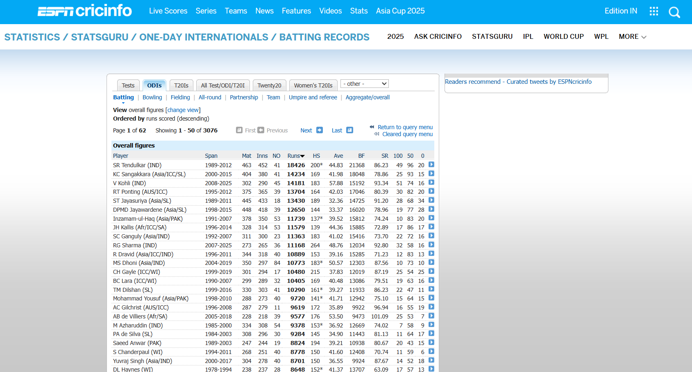
First Look of Website

Slide 6
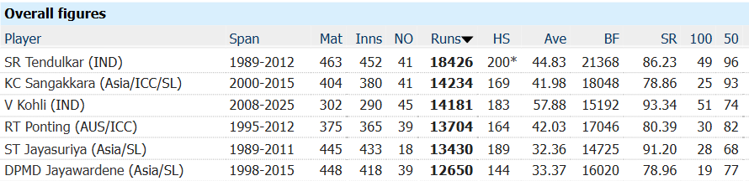
Extracting the content form table
Highest Score
Start/End = Year
Name
Country
Matches
Runs
Average
Century
Innings
Strike Rate
Ball Faced
Not Ball
Fifty

Slide 7
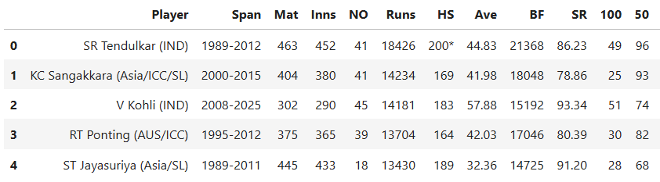
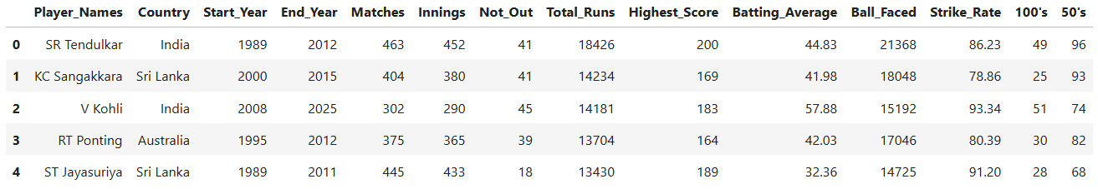
Old Data Frame
New Data Frame

Slide 8
Exploratory Data Analysis (EDA)
Importing required libraries for EDA
(Pandas,Matplotlib,Seaborn)
Exploratory Analysis
Cleaning the data
Remove unwanted strings and symbols
Check for missing / NaN values
Treat them by valid category
Remove the outliers
Remove Duplicate Entries in Data

Slide 9
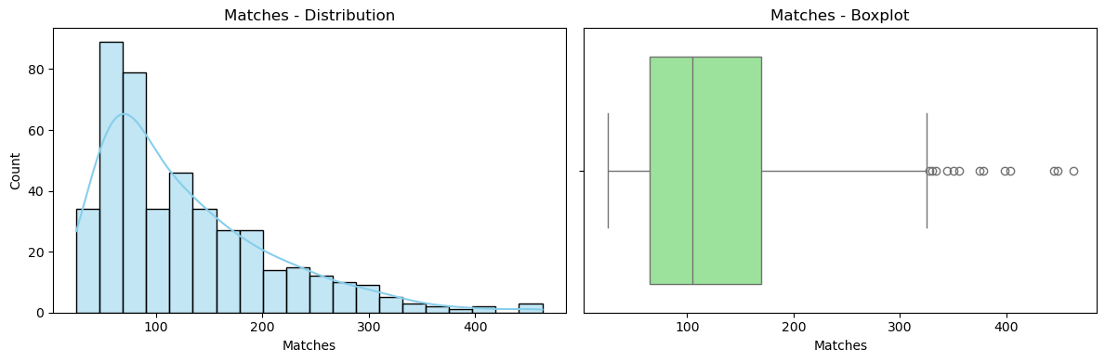
Univariate Numerical Analysis
Matches Distribution of Players.
Most players play 50-170 matches in their careers.
The Data is right-skewed-many play fewer matches, only a few play very high matches.
The median career length is about 100 matches.
A small number of players are outliers with 300+ matches(Very long careers).

Slide 10
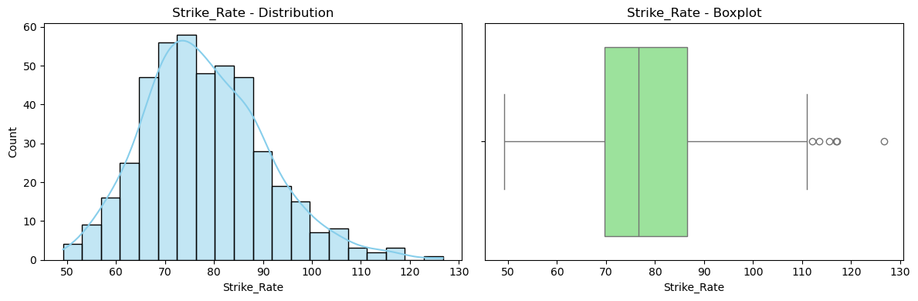
Univariate Numerical Analysis
Strike Rate Distribution of Matches.
Most Players have strike rates around 70-90, while only a few exceptional players have very high strike rates(110+)

Slide 11
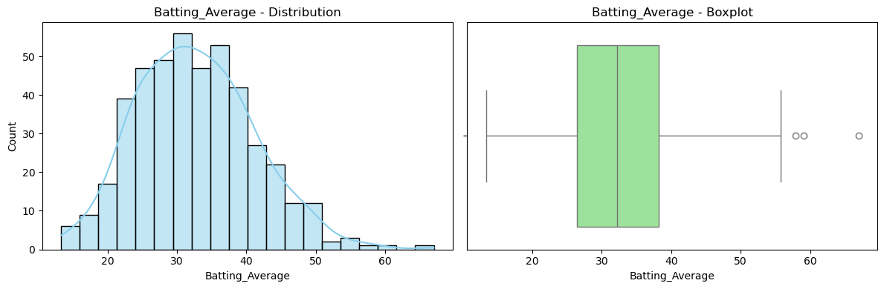
Univariate Numerical Analysis
Batting Average Distribution of Matches.
Most players have a batting average between 25-40.
The median batting average is around 30-32.
A few outliers (60+) indicate exceptionally consistent player with very high averages.

Slide 12
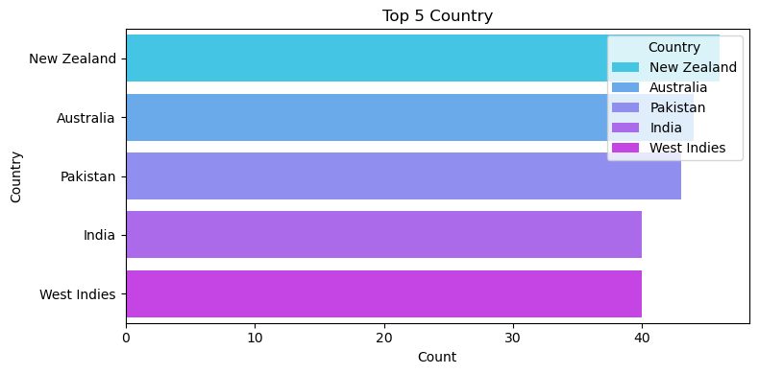
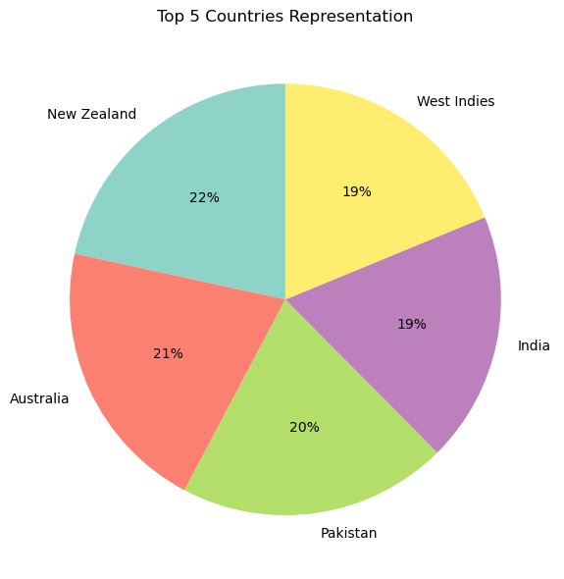
Univariate Categorical Analysis
Top 5 Countries in ODI Batting.
New Zealand has the highest representation among the top 5 countries, showing strong player participation or dominance in this dataset.
Australia and Pakistan are close contenders, with nearly equal counts, indicating balanced performance or presence.
India and West Indies have slightly lower counts, but they are still significant enough to make the top 5, highlighting their consistent contributions

Slide 13
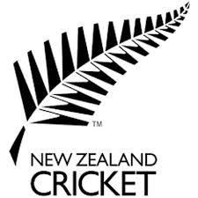
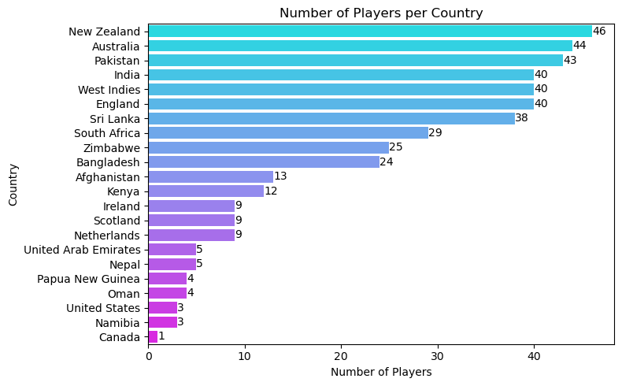

Bivariate Analysis
Number of Players per Country.
Top cricketing nations: New Zealand, Australia, Pakistan, India, West Indies, and England each have 40+ players.
Mid-tier nations: Sri Lanka and South Africa have moderate representation.
Lower-tier nations: Zimbabwe, Bangladesh, Afghanistan, and others contribute fewer players.

Slide 14
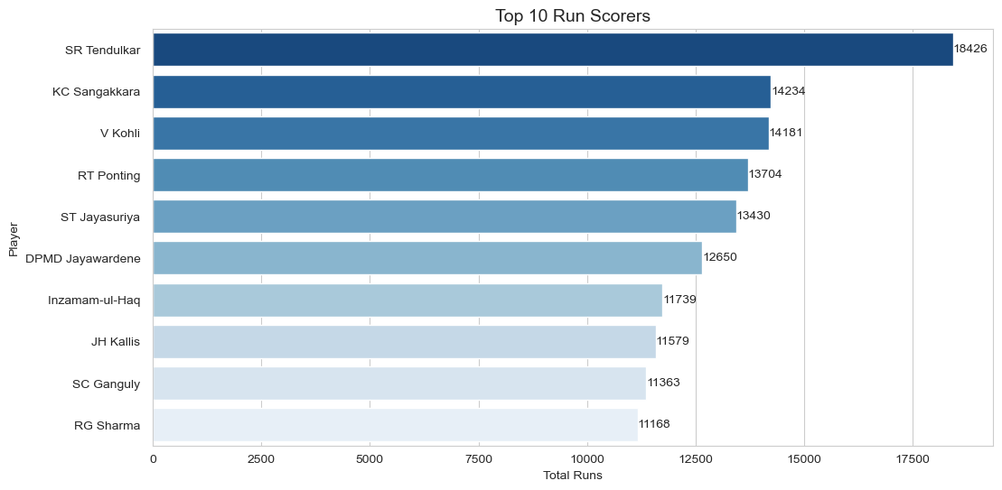
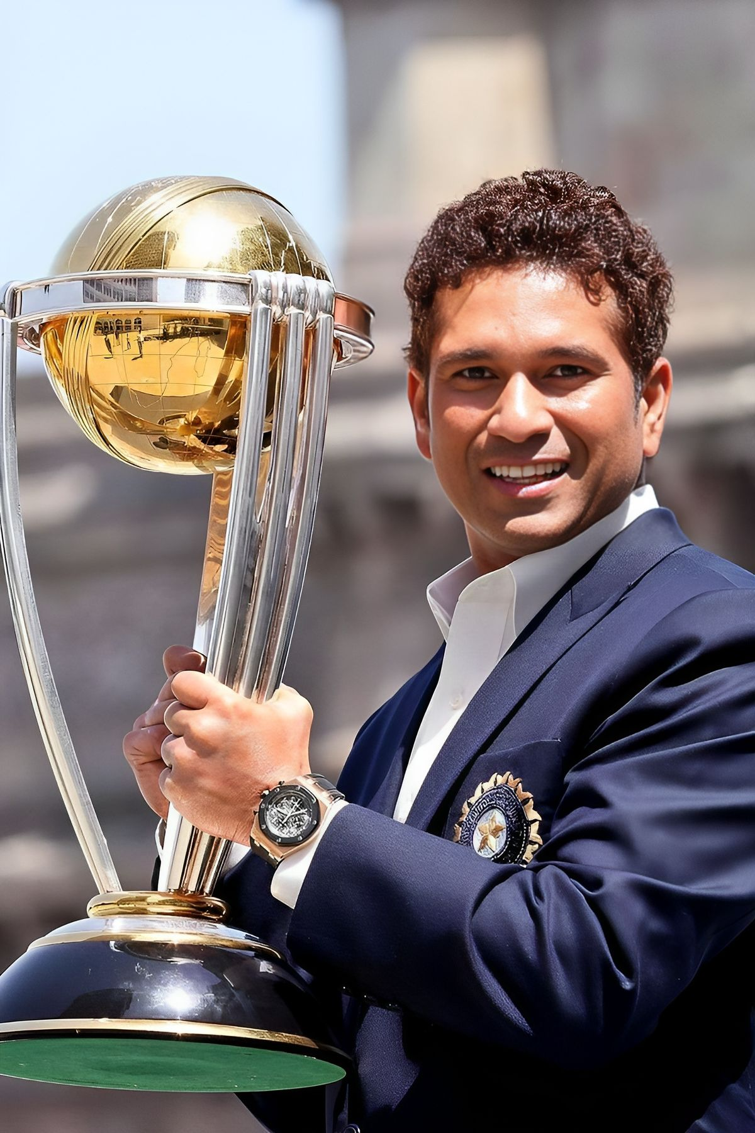
Bivariate Analysis
Top 10 Run Scores.
Sachin Tendulkar dominates with over 18,000 runs, far ahead of all other players, showing his unmatched consistency.
Kumar Sangakkara and Virat Kohli follow closely behind, both with over 14,000 runs, proving their exceptional performance.
The rest of the players (Ponting, Jayasuriya, Jayawardene, etc.) have impressive tallies between 11,000–13,000 runs, but there’s a noticeable gap compared to the top scorer.

Slide 15
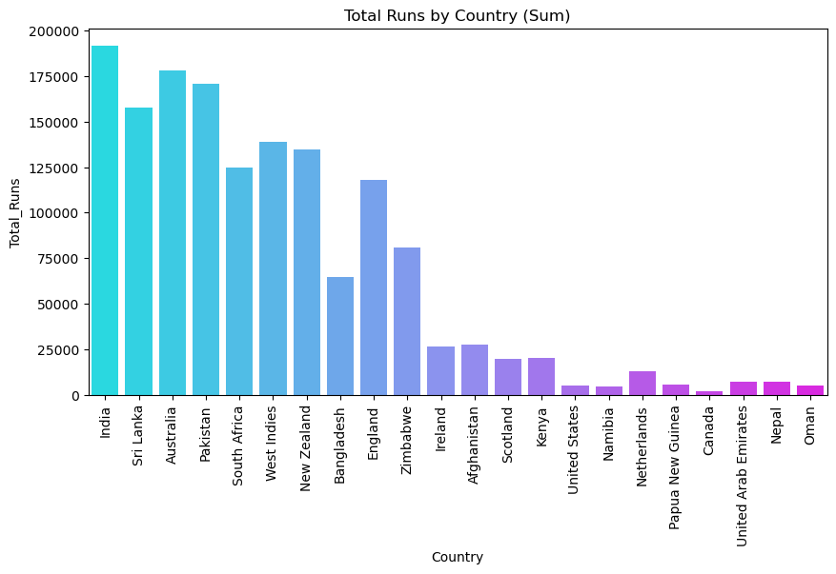
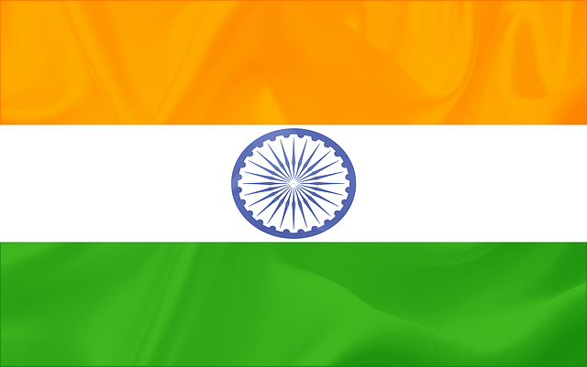
Bivariate Analysis
Total Runs by Countries.
India dominates with the highest total runs, showing strong batting depth over time.
Sri Lanka, Australia, and Pakistan also have very high totals, forming the next strongest group.
Smaller cricket nations like Nepal, Oman, and UAE have much lower totals, highlighting fewer matches or less experience.

Slide 16
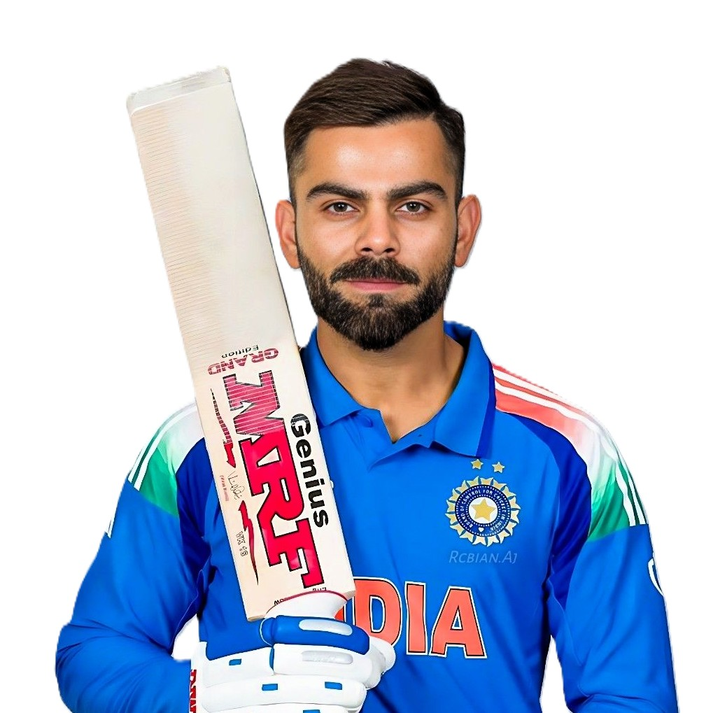
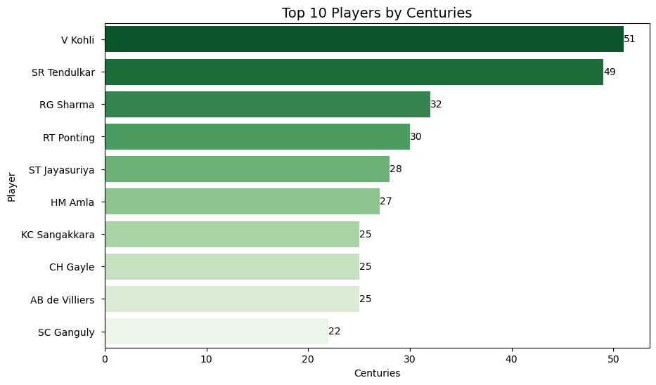
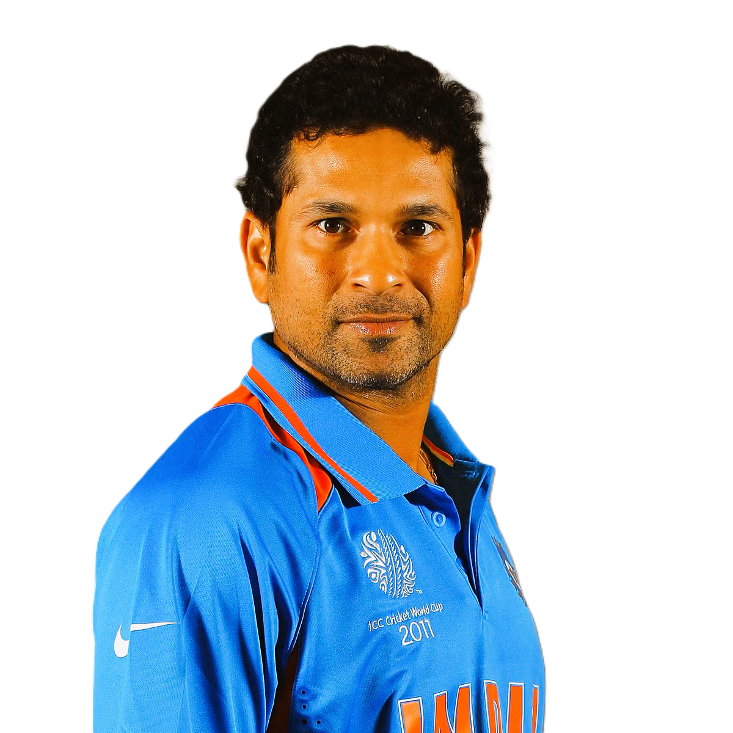
Bivariate Analysis
Top 10 Players by Centuries.
Top Performers: Virat Kohli and Sachin Tendulkar are clear leaders with 51 and 49 centuries, far ahead of others.
Mid-tier Group: Players like Rohit Sharma, Ponting, and Jayasuriya are in the 30–28 century range, showing consistent performance.
Close Competition: Several legends like Sangakkara, Gayle, and AB de Villiers are tied at 25 centuries, highlighting a competitive group.

Slide 17
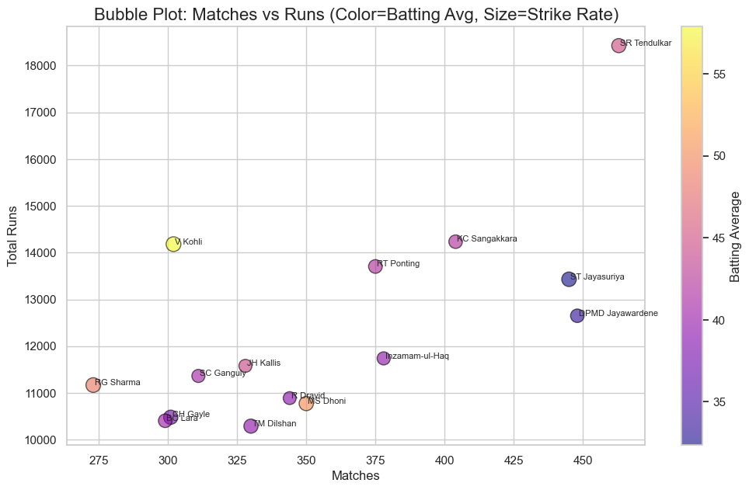
Multivariate Analysis
Matches vs Runs Distribution :
More matches = more runs – Players who played more matches generally scored more runs.
Kohli has best average – Even with fewer matches, Virat Kohli has the highest batting average.
Big hitters have high strike rates – Players like Criss Gayle and Rohit Sharma score faster.

Slide 18
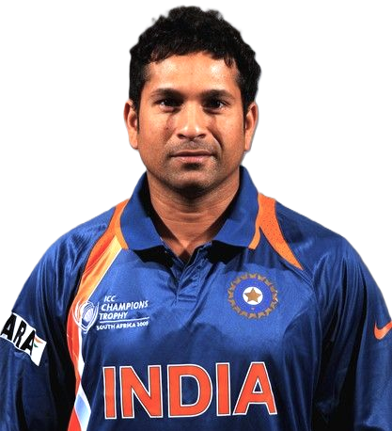
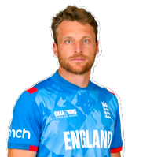
🔑 Key Insight
Top Run-Scorer : Sachine Tendulkar(India) -> 18426, 49 centuries.
Highest Strike Rate : Jos Buttler(England) -> SR~118, shows modern aggressive style.
Most Centuries in ODIs : Virat Kohli (India) -> 51 centuries.
Matches vs Runs : Kumar Sangakkara (Sri Lanka) -> Long career 400+ matches, 14000+ runs.
Country Dominance : India, Australia, Sri Lanka consistency produce top ODI batters.

Slide 19
🔑 Key Insights – Top 5 ODI Batting Legends
Player | Country | Runs | Avg | Strike Rate | 100’s | 50’s
Sachin Tendulkar | India | 18426 | 44.8 | 86.2 | 49 | 96
Kumar Sangakkara | Sri Lanka | 14234 | 41.9 | 78.9 | 25 | 93
Ricky Ponting | Australia | 13704 | 42.0 | 80.4 | 30 | 82
Jayasuriya | Sri Lanka | 13430 | 32.4 | 91.2 | 28 | 68
Virat Kohli | India | 13848 | 58.7 | 93.6 | 50 | 70

Slide 20
Conclusion ✅
I collect and cleaned ODI batting data using web scraping.
EDA help me find important patterns in player performance.
A few top players score most of the runs and centuries, while many stay in the mid-range.
Strike rates are higher in the modern era, showing a more aggressive style.
More matches usually mean more runs, but batting averages differ widely.
This project shows how data helps compare players, find trends, and support cricket strategies.

Slide 21

Thank You !

